Slide 1

Fiscal Year 2019
Audit Presentation

Slide 2
Audit Reports
Independent Auditors Report
  Unmodified or “clean opinion”.
Report on Compliance and on Internal Control over Financial Reporting
  No material weaknesses noted.
  No significant deficiencies noted.
State Compliance Report
  The General Grants Fund over expended its budget by $12,994.

Slide 3
Government-Wide Financial Highlights
Total net position (equity) was $7,810,202.
Over time, increases or decreases in net position are indicators of whether the financial health of the City is improving or deteriorating.
The City’s net position decreased by $1,215,070 for the year ending June 30, 2019.

Slide 4
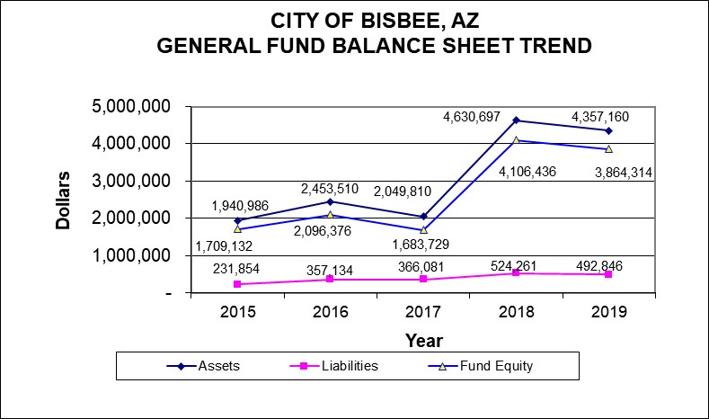
The General Fund continues to report a healthy fund balance.
In 2019 fund balance decreased $242,122.
  $2,000,000 of the City’s fund balance has been committed for the construction of City Hall.
(Keep in mind that fund balance represents equity based on a current measurement focus, i.e., capital assets and long-term debt are not considered)

Slide 5
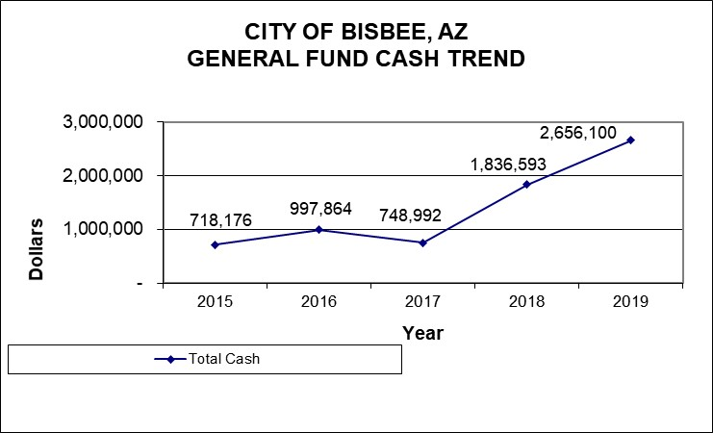
The large increase in cash in 2018 was due to insurance proceeds (approximately $50k was received in fiscal year 2019 from insurance proceeds).

Slide 6
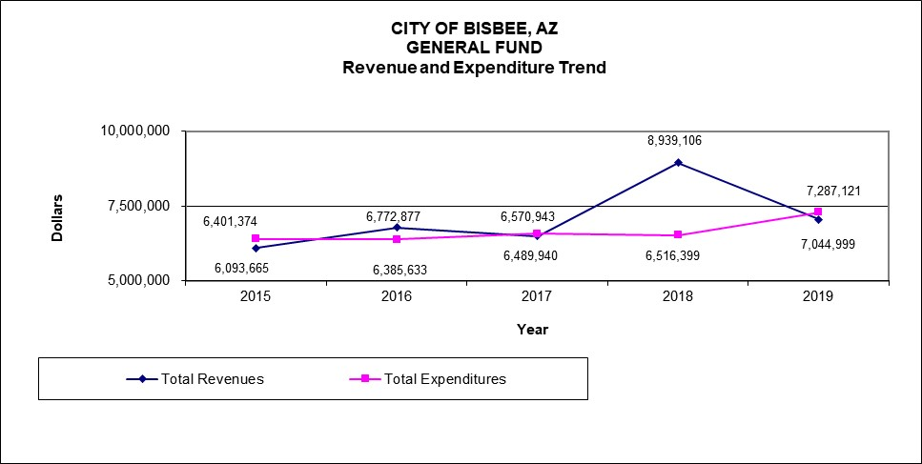
General Fund revenues and expenditures are normally expected to break even over time.
Cumulatively, over the past five years, expenditures have exceeded revenues by $518k (excluding insurance proceeds).

Slide 7
Enterprise Funds
Enterprise Funds are reported on the full accrual basis of accounting.
    This is to provide for depreciation and future capital requirements.
    Enterprise Funds should report revenues in excess of expenditures.

Slide 8
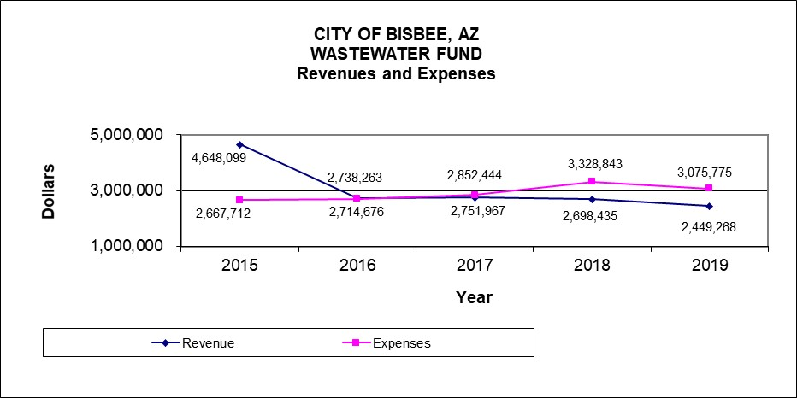
Cumulatively, over the past five years, revenues have exceeded expenses by $646,582.
In fiscal year 2015, the Fund received $1,985,584 in grant revenue.
If the grant revenue is disregarded, the Fund would have cumulatively reported $1,339,002 of expenses in excess of revenues.

Slide 9
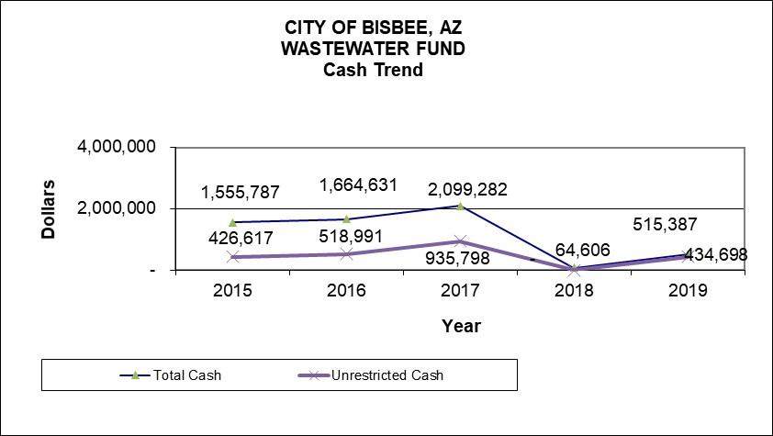
The Wastewater Fund has reported relatively stable cash balances for four out the past five years.
The large decrease in cash reported in 2018 is a result of retiring outstanding debt.
At the beginning of 2018 year outstanding loans and bonds were $11,086,034.
At the end of 2018 outstanding loans and bonds were $8,621,104.

Slide 10
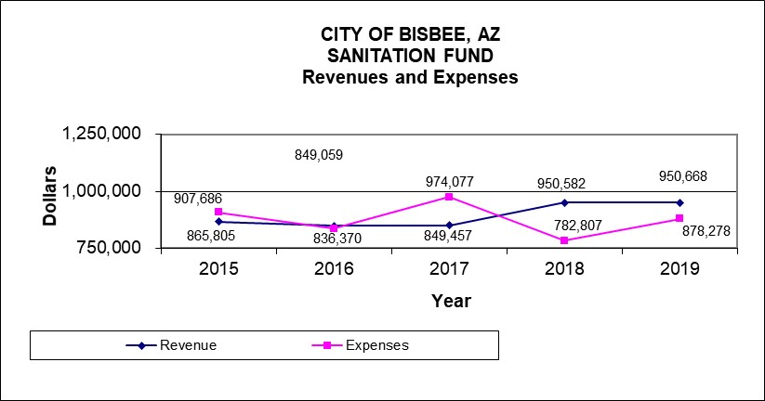
Cumulatively, over the past five years, revenues have exceeded expenses by $86,353.
In fiscal year 2019, revenues exceeded expenses by $72,390.

Slide 11
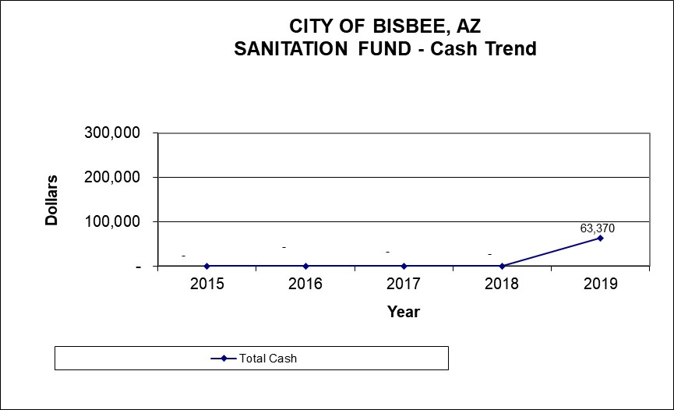
The Sanitation Fund has not reported any cash balances for four of the past five years.

Slide 12
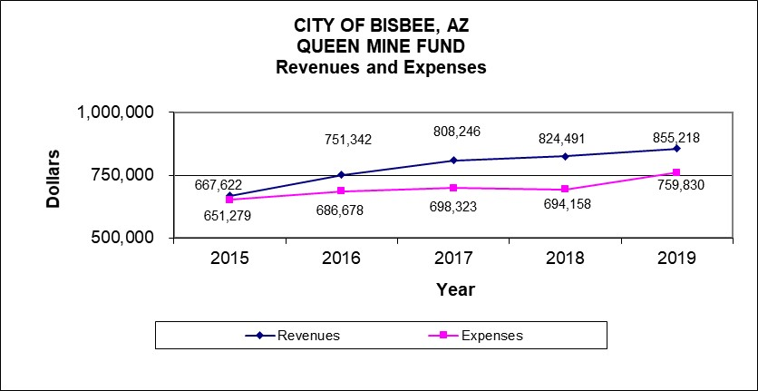
Cumulatively, over the past five years, revenues have exceeded expenses by $416,651.

Slide 13
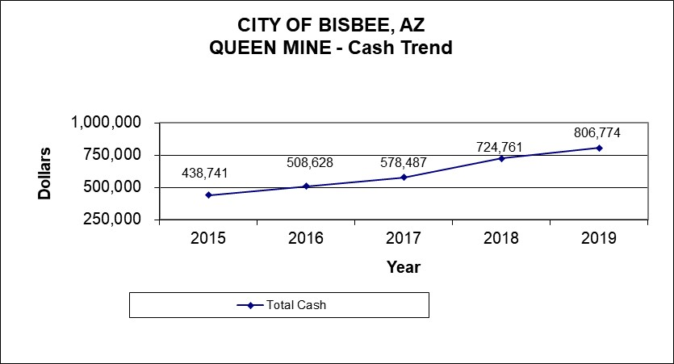
The cash balance in the Queen Mine fund has increased $368,033 over the past five years.

Slide 14
Thank You!
Thank you for the opportunity to work with the City.
Thanks to all City employees that assisted with the audit.

Slide 15
Questions?
Jennifer Frank
888-566-1277
jfrank@hintonburdick.com

